Slide 1
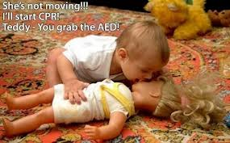
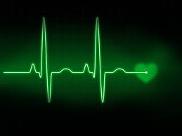
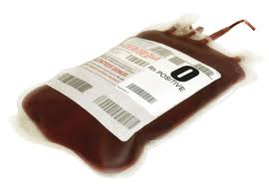
CIRCULATION ASSESSMENT

Slide 2
NENA Core Competencies
ASSESSMENT, INTERVENTION AND MONITORING OF CIRCULATORY STATUS IS A COMPETENCY REQUIRED BY ALL EMERGENCY NURSES

Slide 3
NENA Core Competencies
Recognition and treatment of shock syndromes for the adult/pediatric/geriatric patient: cardiogenic, hypovolemic, distributive, and obstructive
Initiates early sepsis screening and interventions
Interpretation of vital signs
Assessment of effective circulation in the pediatric patient (central and peripheral pulses, capillary refill, skin color, temperature and moisture)
Auscultation and identification of normal and abnormal heart sounds
Perform and maintain IV access
Perform and/or assist with insertion and maintenance of intraosseous access
Understanding/utilizing principles of rapid fluid administration/devices

Slide 4
NENA Core Competencies
Understands/utilizes principles of blood transfusion
Understanding/utilizing principles of massive transfusion
Administering all types of fluid replacement (i.e. crystalloids, plasma expanders, blood products)
Interpretation of lab values
Assist with insertion of central venous and arterial lines
Accessing and drawing blood from central lines and intravenous access devices

Slide 5
NENA Core Competencies
INITIAL CARDIOVASCULAR ASSESSMENT, INTERVENTION AND MONITORING IS A COMPETENCY REQUIRED BY ALL EMERGENCY NURSES

Slide 6
NENA Core Competencies
Assessment and knowledge of interventions for Acute Coronary Syndromes
Basic cardiac monitoring and interpretation
Perform and interpret 12 and 15/16 lead ECG’s
Knowledge of Fibrinolytic protocols
Knowledge of Targeted Temperature Management protocols
Perform and/or assist with defibrillation, cardioversion and external pacing
Assist with pericardiocentesis
Knowledge and interventions related to pharmacology and protocols for the cardiovascular system (i.e. antiarrhythmics, antihypertensives, vasopressors, inotropes)

Slide 7
Circulation - Objectives
Life threatening Circulatory Emergencies
Cardiac Arrest
Cardiac Trauma
Cardiac Tamponade
Aortic Disection/Rupture
Cardiogenic, Obstructive, Distributive & Hypovolemic Shock.
>

Slide 8
Circulation - Objectives
Specific Cardiovascular Emergencies
Heart Failure
Acute pericarditis
Aortic aneurysm
Hypertension crisis
Acute Coronary Syndrome (ACS) \ Acute MI (AMI)

Slide 9
The Heart
Four chambered hollow muscular, organ
2 atrium (2 mm thick)
2 ventricle (LV 15 mm)
Surrounded by membranous sac known as the pericardium
Purpose is to pump blood

Slide 10
Cardiovascular System
Goal: adequate cardiac output to ensure oxygen reaches the tissues of the body thereby tissue perfusion

Slide 11
Cardiac Output
Cardiac Output (CO= 4.5-6 L/min)
= Heart Rate x Stroke Volume

Slide 12
Preload & Afterload
Preload
Stretch on the walls of the ventricles at the end of diastole (just prior to contraction)
How can we alter preload?
Afterload
The resistance against which the ventricles must pump to eject blood
87 y.o. male with acute SOB/CP & BP 225/140. What med can we give him?

Slide 13
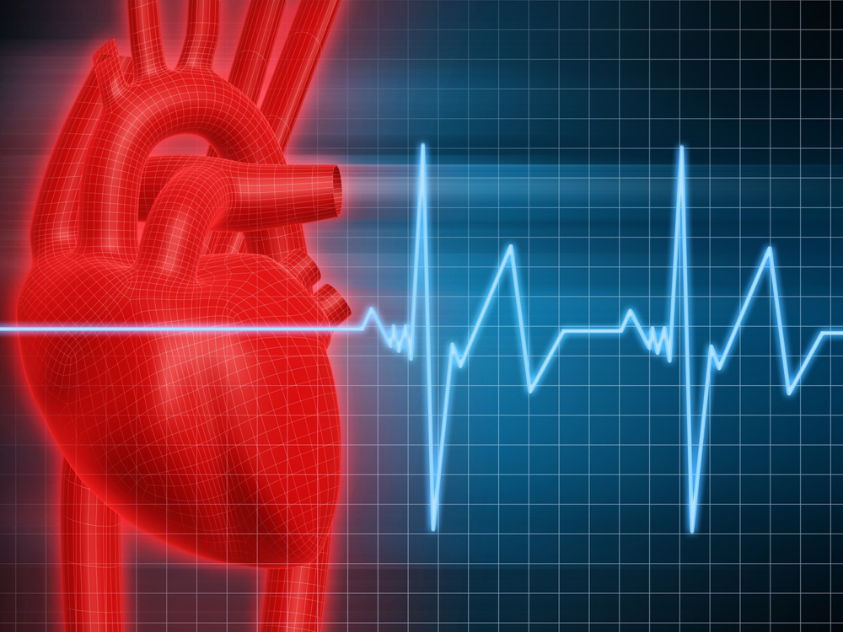
Airway Breathing Circulation

Slide 14
Circulation Assessment
A B C D assessment
(Critical look from across the room)
Targeted Assessment
related to complaint
Documentation

Slide 15
Circulatory Assessment
Pulse (central vs. peripheral)
weak, strong
Skin perfusion (cap refill)
Temperature, colour, moisture
Bleeding sites
IV sites
Level of consciousness (LOC)

Slide 16
Circulatory Assessment
Evaluate BP
obtain NIBP/oximetry (ability to)
both arms/orthostatic VS
Compare manual vs. automatic
Pain assessment
Monitor ECG interpretation
dizziness, syncope, palpitations
Auscultate breath & heart sounds

Slide 17
Circulatory Assessment
Patient history:
OPQRST mnemonic:
what precipitates the discomfort
the quality of the discomfort
does it radiate to other area of the body
the severity of the pain (0 to 10)
the timing of the current episode
OLD CART acronym:
Onset, Location, Duration, Characteristics, Accompanying symptoms, Radiation, Treatment

Slide 18
Circulatory – Additional Assessment
Fatigue/weakness
Dizziness
Edema
Nausea /vomiting
Urine output

Slide 19
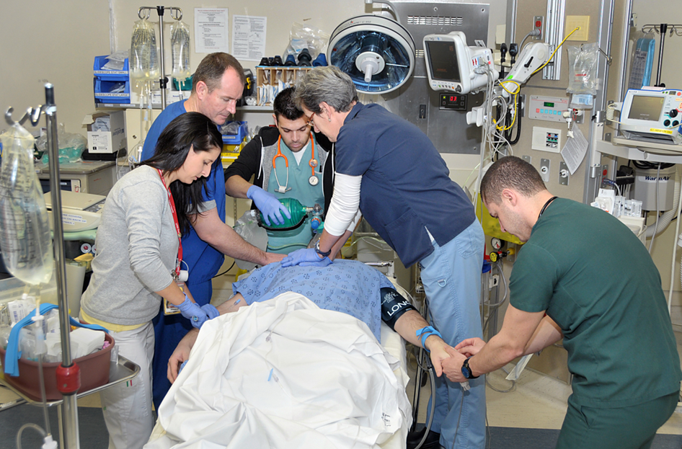
Life Threatening Circulatory Emergencies

Slide 20
Cardiac Arrest - VSA
Vital Signs Absent
Sudden cardiac arrest can be defined as non-traumatic death resulting from cardiac causes that occurs within 1 hour of symptoms

Slide 21
CAUSES OF ARREST
HYPOVOLEMIA
HYPOXIA
HYDROGEN ION (ACIDOSIS)
HYPO/
HYPERKALEMIA
HYPOTHERMIA
HYPOGLYCEMIA
TOXINS
TAMPONADE, cardiac
TENSION PNEUMO
THROMBOSIS
TRAUMA(hypovolemia, increased ICP)

Slide 22
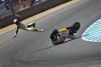
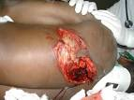
Cardiac Trauma
Blunt trauma
Cardiac contusion
Penetrating injury
left ventricle most injured
high mortality injuries

Slide 23
Cardiac Trauma
Suspect
with rib fractures (Which ribs?)
bruising –seat belt
S|S
dysrhythmias
chest pain, abrasions, ecchymosis
hypotension, shock

Slide 24
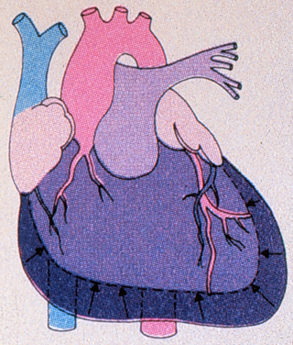
Pericardial Tamponade
Collection of blood in the pericardial sac
Penetrating injury most common
Results in decreased cardiac output
Notes:
Pericardial tamponade is a collection of blood in the pericardial sac. This is a life-threatening cardiac injury.
Penetrating chest wounds are the most common injury associated with pericardial tamponade. Fractures of the left 3rd, 4th, or 5th ribs should also increase suspicion.
As blood accumulates in the non-pliant sac, it exerts pressure on the heart, inhibiting ventricular filling.

Slide 25
Pericardial Tamponade
Signs and Symptoms
Dyspnea
Cyanosis
Beck’s triad
Signs of shock
Decreased voltage of ECG complexes
Notes:
Signs and symptoms of a pericardial tamponade may include:
Dyspnea
Cyanosis
Beck’s triad: distended neck veins, hypotension (fall in systolic pressure), and muffled heart tones; triad only occurs in 10 to 40% of patients
Signs of shock
Decreased voltage of ECG complexes

Slide 26
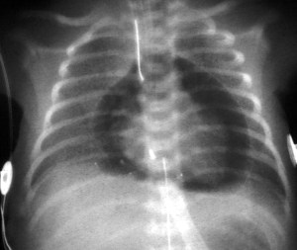
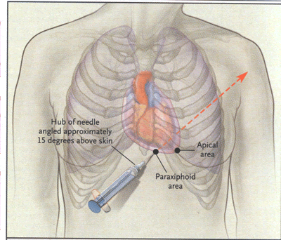
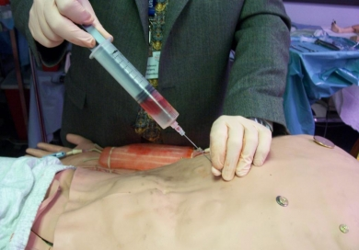

Slide 27
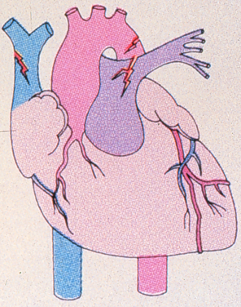
Aortic Injuries
Result of penetrating and blunt trauma
Descending aorta more susceptible to rupture
10 to 30% mortality in those admitted
Ascending aorta immediately fatal
Notes:
Injuries to the thoracic aorta may be the result of penetrating or blunt trauma.
Injury to the descending aorta usually occurs at the aortic isthmus distal to the ligamentum arteriosum because the aorta is relatively fixed and shearing forces tear the aorta from the fixed point. There is an 85% mortality prior to arrival at a hospital. From those admitted and who received surgical intervention, an additional 10% to 30% will die.
Ascending aortic injuries are fatal in most cases.

Slide 28
Aortic Dissection
Tear in the inner layer of the aorta, the large blood vessel branching off the heart.
Blood surges through the tear, causing the inner and middle layers of the aorta to separate (dissect).
If the blood-filled channel ruptures through the outside aortic wall, aortic dissection is often fatal.

Slide 29
Aortic Injuries
Signs
Hypotension
Decreased level of consciousness
Decreased quality of femoral pulses
Loud systolic murmur in parascapular region
Chest wall ecchymosis
Widened mediastinum on chest radiograph
Paraplegia
Notes:
Signs and symptoms aortic injuries include:
Hypotension; although, there may be hypertension in the upper extremities.
Decreased level of consciousness
Decreased quality (amplitude) of femoral pulses when compared to upper extremity pulses
Chest pain or back pain—may be sharp
Chest wall ecchymosis
Chest radiograph may show a widened mediastinum
Paraplegia

Slide 30
Aortic Injuries
Symptoms
Severe & sudden ripping, tearing midsternal chest pain.
May radiate to back
Nausea
Shortness of breath
Shock

Slide 31
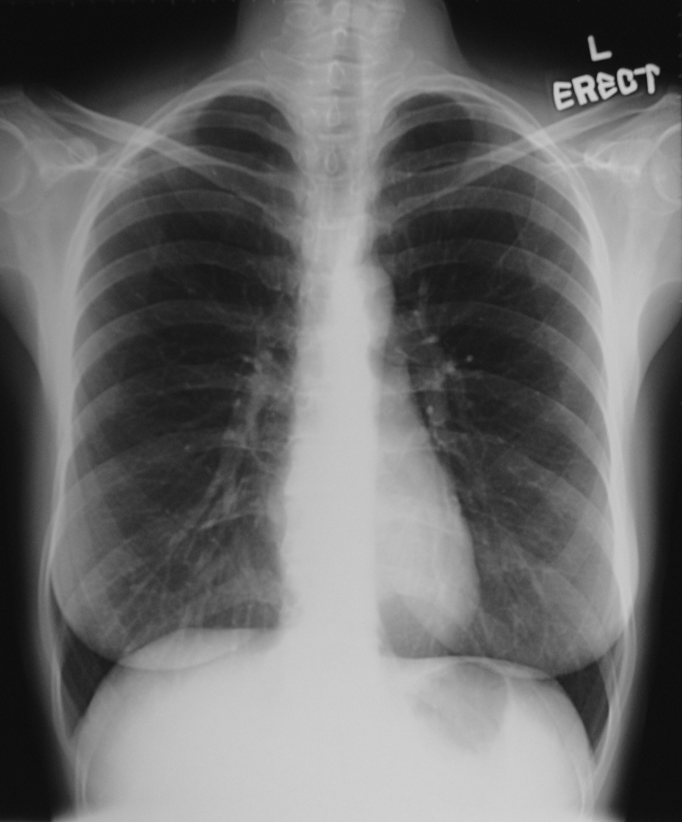
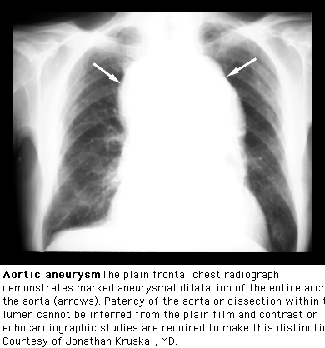
Notes:
Classic “wide” mediasteinum

Slide 32
Cardiac Output – It’s all about Cardiac Output
Assess for changes in:
mentation
Skin colour, temperature & moisture

Slide 33
Symptoms
tachycardia
weak pulse
central vs. peripheral
tachypnea
cool, clammy skin
delayed cap refill
altered loc
oliguria, anuria

Slide 34
Shock

Slide 35
Shock
Shock is inadequate tissue perfusion resulting oxygen debt at the cellular level.
Due to failure of one of the components that affects the delivery of oxygen and nutrients to the cells--
the heart
the vascular system or
circulating blood volume
Notes:
Leading to multisystem organ failure

Slide 36
Pathophysiology—Vascular Response
Response occurs immediately
Peripheral vasoconstriction
Arterioles constrict to increase total peripheral resistance
Venous capacitance system vasoconstricts
Notes:
The compensatory mechanisms of the body can be described by organ systems. Key compensatory mechanisms will be described over the next few slides.
The vascular system responds in several different ways and occurs immediately.
Peripheral vasoconstriction occurs as a result of sympathetic stimulation from baroreceptor inhibition
Arterioles constrict to increase total peripheral resistance resulting in an increase in blood pressure.
The venous capacitance system vasoconstricts to improve venous return to the right atrium.

Slide 37
Pathophysiology—Chemoreceptor Response
Sensitive to low levels of oxygen and excess levels of carbon dioxide
Arterial blood pressure must be less than 80 mmHg
Notes:
Chemoreceptors are sensitive to low levels of oxygen and excess levels of carbon dioxide in arterial blood. When chemoreceptors are stimulated, the result is vasoconstriction.
Arterial blood pressure must be less than 80 mmHg to activate the chemoreceptor response.
The chemoreceptor response is very rapid and is initiated within seconds of changes in blood pressure.

Slide 38
Pathophysiology—Cerebral Response
Blood flow to major organs is preserved
Brain and heart autoregulate blood flow based on the needs of the tissues
Blood pressure below 50 mmHg leads to cerebral ischemia
Notes:
The primary goal of the body is to maintain perfusion to the brain, heart, and lungs. The blood flow to these major organs is preserved during shock states.
Sympathetic stimulation (compensatory vasoconstriction) has little effect on the cerebral and coronary vessels because the brain and heart can autoregulate blood flow based on the needs of the tissues.
If blood pressure drops below 50 mmHg, cerebral ischemia occurs. Accumulation of carbon dioxide in the brain’s vasomotor center will stimulate the central nervous system’s ischemic response which leads to further stimulation of the sympathetic nervous system.

Slide 39
Pathophysiology—Renal Response
Notes:
In the renal response, renal ischemia activates the release of renin.
Renin causes angiotensinogen to release angiotensin I. Angiotensin I is converted to angiotensin II in the lungs.
Effects of angiotensin II:
Vasoconstriction of arterioles and some veins
Sympathetic nervous system stimulation
Retention of water by the kidneys
Release of aldosterone from the adrenal cortex
The renin-angiotensin mechanism takes anywhere from 10 to 60 minutes to fully activate. Decreased urinary output may be an early sign of renal hypoperfusion but it is also an indicator that there is systemic hypoperfusion.

Slide 40
Pathophysiology—Adrenal Response
Increased release of catecholamines
Cortisol is released from the adrenal glands
Notes:
There is an increased release of catecholamines (epinephrine and norepinephrine) from the adrenal medulla which:
Stimulates receptors in the heart to increase cardiac output (contractility and heart rate) and ultimately improves blood pressure; and
Causes vasoconstriction
Cortisol is released from the adrenal glands in response to ACTH released from the pituitary gland. The effect of cortisol release is an elevation in blood sugar subsequent to increased insulin resistance and gluconeogenesis.
Cortisol also causes the renal retention of water and sodium, a compensatory mechanism to conserve body water.

Slide 41
Pathophysiology—Hepatic Response
Glycogenolysis is activated by epinephrine
Blood flow is redirected to other vital areas through hepatic vasoconstriction
Notes:
Excess glucose is stored in the liver in the form of glycogen.
Glycogenolysis is activated by epinephrine to break down glycogen into glucose.
As a compensatory response, hepatic vessels constrict to redirect blood flow to other vital areas.
However, prolonged vasoconstriction increases risk for hepatic ischemia and compromise of liver function.

Slide 42
Pathophysiology—Pulmonary Response
Tachypnea
Acid-base balance
Increased oxygen supply
Notes:
Anaerobic metabolism results in metabolic acidosis. As the shock state persists, the metabolic acidosis is the stimulus for increased rate and depth of ventilation. This increased ventilation is an attempt to correct the metabolic acidosis.
The increased rate of ventilation is also the body’s attempt to maximize oxygen delivery to the alveoli.

Slide 43
Types of Shock
Hypovolemic**
Cardiogenic
Distributive**
Obstructive
**most common in children

Slide 44
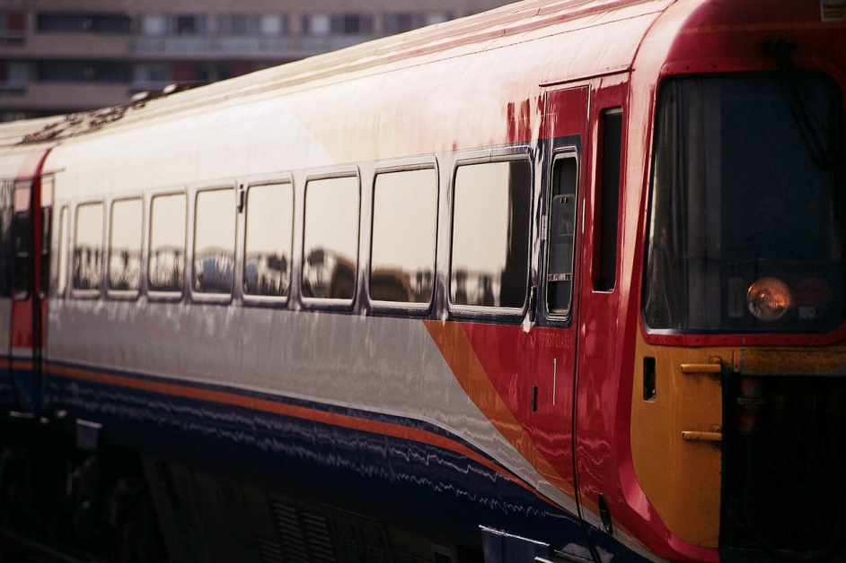
Hypovolemic Shock
Decrease in circulating blood volume
Most common form of shock
Results from:
Whole blood loss from hemorrhage
Leakage of plasma and proteins from the intravascular space when cell membrane integrity is impaired (GI bleeds, ruptured ectopic, burns, dehydration)
Notes:
Shock can be classified in a number of ways. For the purposes of this course, classification is based on underlying pathology.
Hypovolemic shock is a decrease in the circulating blood volume and is the most common form of shock.
Hypovolemic shock is most frequently caused by whole blood loss from hemorrhage; but may occur when there is leakage of plasma and proteins from the intravascular space to the interstitial space, such as with a burn.

Slide 45
Classes of Shock
Class 1
Class 2
Class 3
Class 4
Blood loss
15%
15 to 30%
750-1500cc
30 to 40%
1500-2000cc
>40%
>2000cc
BP
normal
normal
↓↓
↓↓↓↓
HR
< 100
>100
>120
>140
LOC
anxious
Anxious and confused
Confused lethargic
Urine
>30
20 to 30
5 to 15
<5
Blood donation is about 500cc\10% blood volume

Slide 46
Interventions
ABCs--CPR
Oxygen
Control external bleeding
Establish IV—large bore #16, 18
IO, central line
replacement of lost fluids (warmed)
pressure infusers
blood replacement--universal donor
Foley
Frequent reassessment

Slide 47
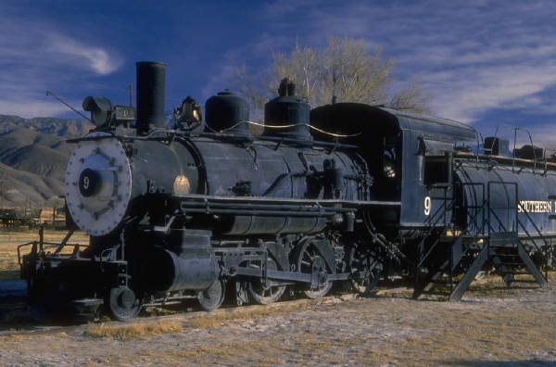
Cardiogenic Shock
Ineffective perfusion caused by inadequate contractility of the cardiac muscles
Causes include:
Myocardial infarction
Dysrhythmias
Blunt cardiac injury
Notes:
Cardiogenic shock is ineffective perfusion caused by inadequate contractility of the cardiac muscles.
Some of the common causes include: myocardial infarction, dysrhythmias, and blunt cardiac injury.

Slide 48
Interventions
ABCs
Cardiogenic:
Cath lab/fibrinolytics
Vasopressors
IABP (art line)

Slide 49

Obstructive Shock
Inadequate circulating blood volume due to obstruction or compression of the great veins, aorta, pulmonary arteries, or heart
Causes include:
Cardiac tamponade
Tension pneumothorax
Air embolus
Notes:
Obstructive shock is inadequate circulating blood volume due to an obstruction or by compression of the great veins, aorta, pulmonary arteries, or the heart itself.
Some of the common causes include: cardiac tamponade, tension pneumothorax, and air embolus.

Slide 50
Interventions
Obstructive
Thoracotomy
Needle thoracentesis
pericardiocentesis

Slide 51
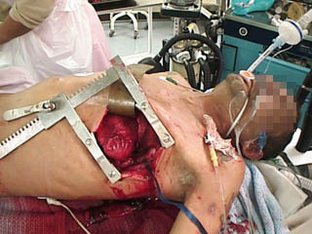
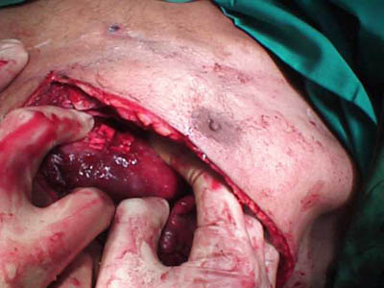
Thoracotomy

Slide 52
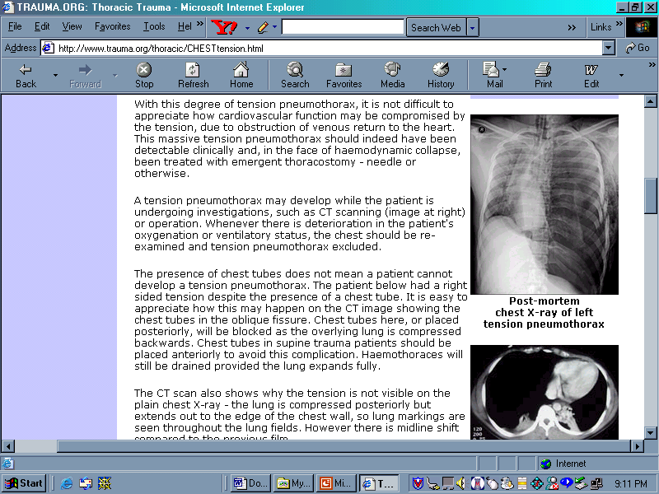
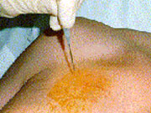

Slide 53

Distributive Shock
Mal-distribution of blood volume and flow (extreme dilation or extreme vasoconstriction)
Causes include:
Neurogenic shock
Anaphylaxis
Sepsis
Notes:
Distributive shock occurs as a result of maldistribution of the blood volume and flow. There is disruption of the sympathetic nervous system control of blood vessel tone which leads to vasodilation and the maldistribution. The loss of vasomotor tone results in peripheral vasodilation which leads to hypotension.
The three types of distributive shock are:
Neurogenic shock which may result from a spinal cord injury;
Anaphylactic shock which occurs due to a severe allergic reaction; and
Septic shock which may result from an overwhelming infection

Slide 54
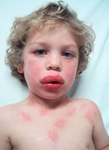
Interventions
Distributive
vasopressors
antihistamine,
H2 blockers
antibiotics
supportive

Slide 55
Anaphylaxis
Local immune response becomes systemic
Treatment guidelines on arrest cart
anaphylaxis kit in bottom drawer
Epinephrine
Benadryl
Ventolin, Steroids, H2 blockers (ranitidine)
Observation

Slide 56
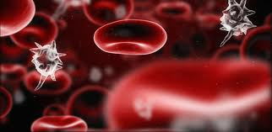
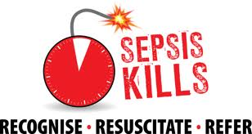
SEPSIS

Slide 57
SIRS CRITERIA
SIRS (Systemic Inflammatory Response Syndrome)
Suspected source of infection

Slide 58
SEPSIS
Recognize infectious complaints
Temperature, VS, LOC
(sepsis screening tool)
Fluids
Early ABX
Cultures, labs, lactate
Vasopressors: norepinephrine vs dopamine
Notes:
Norepinephrine increases mean arterial pressure primarily through vasoconstriction, with little effect on heart rate, stroke volume, and cardiac output; dopamine increases MAP primarily through an increase in cardiac output (by increasing both heart rate and stroke volume).

Slide 59
Sepsis Continuum
Sepsis
Severe sepsis
Multi-Organ Dysfunction Syndrome - Septic Shock

Slide 60
Treatments for Septic Shock
ABCs—CPR
Get the physician and notify the Charge Nurse
Oxygen therapy
Establish IV/RL x 2 & Early Antibiotics!!!
Foley to ensure tissue perfusion.
Frequent reassessment
Goal is to prevent irreversible shock

Slide 61
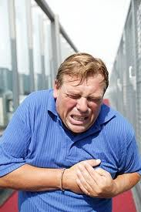
Chest Pain

Slide 62
Chest Pain Differential Diagnosis
Three System Approach!!
ACS: Acute Coronary Syndrome
Ischemic\anginal\myocardial infarction
Pericarditis
Dissecting aortic aneurysm
Esophageal disorders
Musculoskeletal
Anxiety
Post cocaine ingestion
Postop CABG

Slide 63
ACS
Acute Coronary Syndrome
Definition
Pathophysiology
ACS Medical Directive
Interventions, Treatment, and Therapies
ACS Drug Considerations
PTCA
Fibrinolytic therapy (TNKase)

Slide 64
Acute Coronary Syndrome
This syndrome includes cardiac events previously referred to as unstable angina, non ST segment elevation myocardial infarction (MI), and ST segment elevation myocardial infarction (MI)
Includes Q wave MI and non Q wave MI

Slide 65
Unstable Angina
unexpected chest pain, and usually occurs while resting.
Most common cause is reduced blood flow to the heart muscle because the coronary arteries are narrowed by fatty buildups (atherosclerosis)
can rupture causing injury to the coronary blood vessel resulting in blood clotting which blocks the flow of blood to the heart muscle.

Slide 66
Symptoms of Unstable Angina
Often occurs at rest
Comes as a surprise
May last longer than stable angina
Rest or medicine usually do not help relieve it
May get worse over time
Can lead to a heart attack
http://www.uptodate.com/contents/classification-of-unstable-angina-and-non-st-elevation-myocardial-infarction

Slide 67
NSTEMI
This is a Myocardial Infarction
“Development of heart muscle necrosis without the ECG change of ST-segment elevation, resulting from an acute interruption of blood supply to a part of the heart and can be demonstrated by an elevation of cardiac markers (CK-MB or troponin) in the blood.”

Slide 68
Symptoms of NSTEMI
The usual ECG findings of NSTEMI are ST-segment depression or T-wave inversion.
CK rises within 4-6 hours and falls to normal within 48-72 hours.
Troponin start to rise at 4-6 hours and remain high for up to two weeks.

Slide 69
Pathophysiology
An imbalance in myocardial oxygen supply and demand
5 potential causes:
nonocclusive thrombus on preexisting plaque
dynamic obstruction, i.e. vasospasm
progressive mechanical obstruction
inflammation or infection
secondary unstable angina (i.e. anemia, fever, throtoxicosis or hypoxemia)

Slide 70
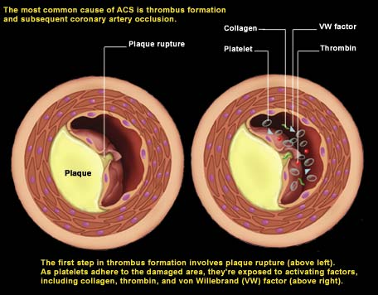
Pathophysiology

Slide 71
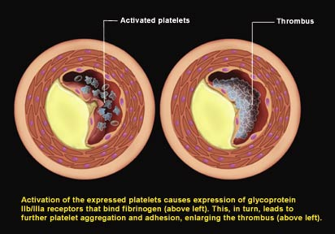
Pathophysiology

Slide 72
Assessment
VS, BP both arms
Cardiac rhythm
Breath sounds (physical exam)
Risk factors:
CAD, angina, or MI
cardiac surgery\procedures
smoking, hypertension, diabetes, hyperlipdemia, family history of CAD, cocaine use
Other medical conditions

Slide 73
Goals of Treatment
Reduction of myocardial necrosis in patients with ongoing infarction
Prevention of major adverse cardiac events (i.e. Death, non fatal MI, and the need for urgent revascularization)
Rapid defibrillation when VF occurs

Slide 74
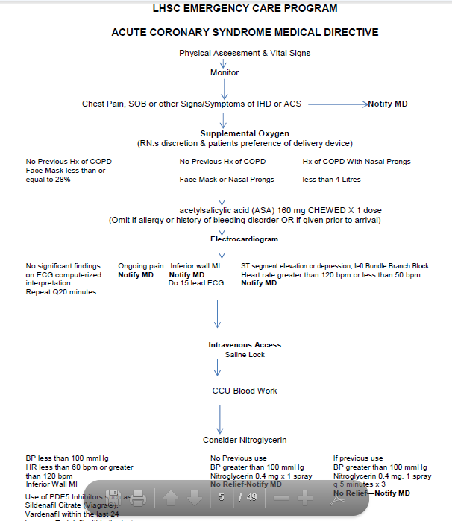

Slide 75
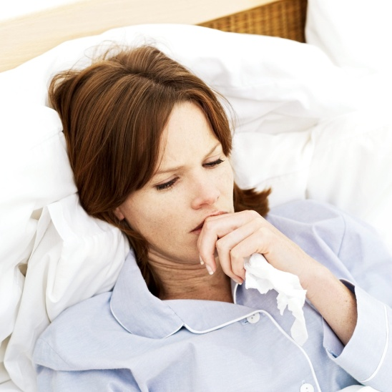
Assessment in Women
Heart Disease is the #1 Killer of women!
Although men and women can experience chest pressure, women can have an MI without chest pressure!

Slide 76
Women and MI’s
Shortness of breath,
Pressure or pain in the lower chest or upper abdomen (epigastrium),
Dizziness, or fainting or extreme fatigue.
Some describe upper back pressure that feels like squeezing or a rope being tied around them.
Women often chalk up the symptoms to less life-threatening conditions like acid reflux, the flu or normal aging.
Be aware that the S & S may be very subtle so be sure to get a 12 lead if any of the above S & S are present ASAP.

Slide 77
https://www.youtube.com/watch?v=_JI487DlgTA

Slide 78
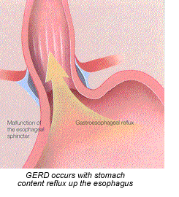
Esophageal disorders
Esophageal reflux or spasm
Often triggered by exercise, food, ETOH
S|S
burning or pressure-like pain
may radiate to jaw or abd.
dysphagia

Slide 79
MSK
S|S: pain with inspiration or with movement
generalized aching, stiffness, point tenderness,
persistent without relief

Slide 80
Chest Pain Assessment: Other Differentials
anxiety
pneumothorax
tachydysrhythmias
Cocaine
post CABG
MVP

Slide 81
PCI
Primary Coronary Intervention
Identify the STEMI and get them to the cath lab ASAP open 24/7
call interventionalist-- get plan
arrange transfer: transport RN, TEMS STAT\critical transfer\STEMI

Slide 82
Fibrinolytics
Early fibrinolytic therapy standard of care for acute ST segment elevation MI
Prolong half life and increase specificity
Door to needle time
Prehospital Fibrinolysis
Combination therapies

Slide 83
ACS Drug Considerations
Antiplatelet drugs
ASA
Clopidogrel(Plavix)
Glycoprotein inhibitors GP IIb\IIIa inhibitors
Heparin
Unfractionated or low molecular weight (enoxaparin)
Fibrinolytics
TNKase
BetaBlockers
Angiotension Converting Enzyme Inhibitors

Slide 84
Conclusion
The old adage applies --time is muscle
Patients triaged with cardiac symptoms must immediately be evaluated for ACS
The ACS Medical Directive gives nurses the autonomy to begin the initial treatment and identify those requiring expedited care to restore coronary perfusion

Slide 85
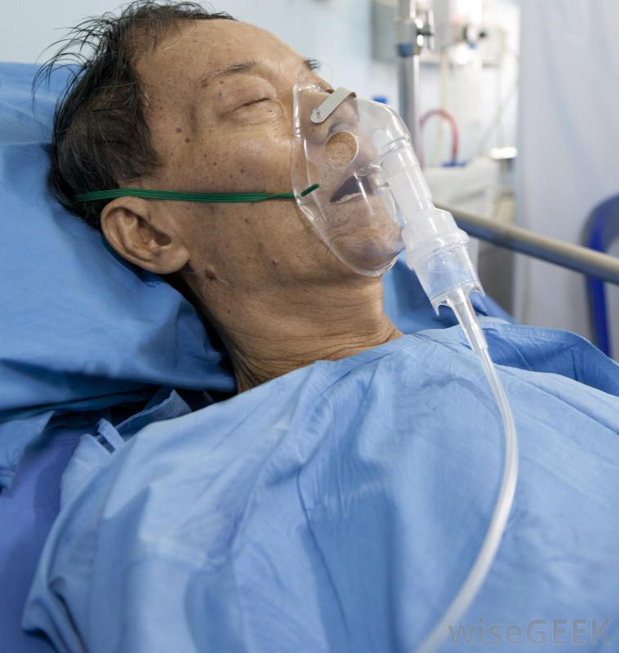
Other Cardiac Considerations:
Heart Failure
Hypertensive Crisis
Congenital Heart Defects

Slide 86
Heart Failure
The hearts inability to pump enough blood to sustain the body`s metabolic needs
A clinical syndrome characterized by S/S:
Vascular and interstitial overload
Inadequate tissue perfusion

Slide 87
Heart Failure
Abnormalities that cause heart failure
systolic and diastolic dysfunction
CAD/ACS
myopathies/hypertrophies/fibrosis
valvular malformation

Slide 88
Heart Failure
Left vs. Right

Slide 89
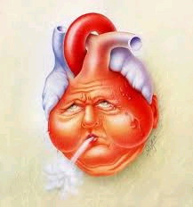
Left Heart Failure
SOB/cough
Fatigue
Orthopnea
Crackles
Tachycardia, tachypnea
S3 or S4
JVD
mental status changes
arrhythmias

Slide 90
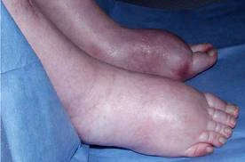
Right Heart Failure
Edema
Peripheral dependent / ascites
Resp. distress
JVD, hepatojugular reflux
hepatomegaly
Fatigue, decreased exercise tolerance
Weight gain, n/v
Pleural effusion

Slide 91
Intervention/Treatment
Oxygen
positioning
diuretics/Morphine – Monitor output!!!
BIPAP/intubation
ACE inhibitors – Ramipril, Captopril
B blockers- Bisoprolol, Metoprolol
transplantation

Slide 92
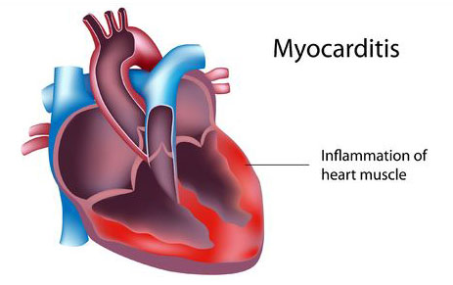
Myocarditis
Cause - usually viral

Slide 93
Myocarditis
Signs - dyspnea, chest discomfort, fever, chills, sore throat, arthralgias \ myalgias
Flu-like symptoms
Symptoms - enlarged heart , heart failure, pericardial effusion, LV hypertrophy, arrhythmias
LV failure, CO, death, cardiomyopathy
Treatment: supportive, transplantation

Slide 94
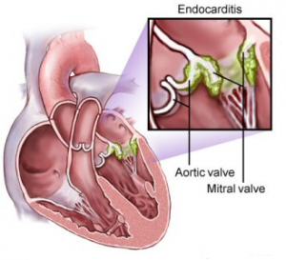
Endocarditis
Cause – Bacteria enters blood stream and attaches to damaged areas of the heart.

Slide 95
Endocartitis
Signs – fever/chills, fatigue, night sweats, cough, paleness (Can occur slow or fast.)
Treatment – As easy as antibiotics to as life saving as an emergency valve replacement.
Major Risk – A damaged heart valve!
Other risks – Dental work, Gum disease, STI, IVDU, Tattoo/Piercing

Slide 96
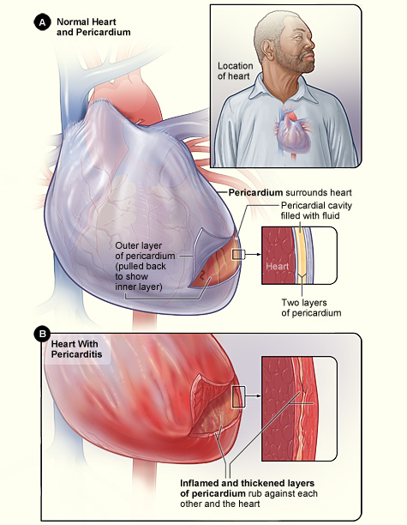
Pericarditis
Swelling and irritation of the pericardial sac.
Begins suddenly and lasts around 2 weeks.
Causes: Post MI or heart surgery, lupus, RA, AIDS, Cancer & URTI.

Slide 97
Pericarditis
Symptoms – Sharp, stabbing chest pain that intensifies with cough, lying down or inhaling deeply.
Sitting up and leaning forward can often ease the pain.
Low-grade fever
An overall sense of weakness, fatigue or feeling sick
Cough

Slide 98
Pericarditis
Treatment depends on the cause & are aimed at reducing inflammation.
NSAIDS
Colchicine
Corticosteroids

Slide 99
Hypertensive Crisis
Rare
diastolic greater than 120mmhg
urgency treatment dependent upon the amount of evident end organ damage, or S|S
determine underlying mechanism--renal disease, drugs, drug interaction, endocrine cause (pheochromocytoma)

Slide 100
Congenital Heart Defects
Children or adult patient population
Post Repairs
Onset between birth and 3 months
Classified Cyanotic and Acyanotic--depending on how they affect the degree of oxygen\carbon dioxide exchange.

Slide 101
Congenital Heart Defects
Cyanotic defects---(right to left shunts)
tetralogy of Fallot, transposition of the great vessels
blood shunts from R to the L or pulm flow is decreased
decreased SpO2, long lasting hypoxemia
cyanosis

Slide 102
Congenital Heart Defects
Acyanotic defects-- (left to right shunts)
atrial septal defects, patent ductus arteriosius, ventricular septal defects
SpO2 is normal
problems with pulmonary hypertension, Ht failure

Slide 103
Case #1
a 63 year male comes to ED with complaint of chest pain while raking leaves associated with palpitations and dyspnea.
described as a pressure sensation
resolved with rest.
3 prior episodes of a similar pain today, lasting about 10min., all with activity.
history: diabetes and hypertension, ex smoker
family history of a sister who had an MI at age 55 years
Notes:
CTAS

Slide 104
Case #2
60 year old male presents to the ED with the complaint of severe, tearing, anterior chest pain radiating to the intrascapular region
smoker
high cholesterol

Slide 105
Case #3
65 year old female with a med. history: Diabetes and angina
presents with epigastric pain radiating into her shoulder. Now lasting 30 mins.
pale, grey, diaphoretic and SOB
the pain started at rest and has not relieved by NTG at home

Slide 106
Case #4
17 year old man arrives with a complaint of chest pain---described as sharp, with radiation to the back and shoulder
He has had a recent URTI

Slide 107
Case #5
60 year old male, complaining of central chest pain radiating to his neck. He says this pain feels exactly like the pain he was having when he had his heart attack 10 years ago. He has vomited once, but is not diaphoretic or short of breath

Slide 108
Case #6
A 35 year old is brought by TEMS
involved in MVC, driver, not wearing his seat belt and hit the steering wheel
Complaining of CP
BP 90\40 mmHg, distended neck veins,
heart sound are muffled

Slide 109
Blood products
Blood transfusion guide
(LHSC on line)

Slide 110
Blood Products
consent required prior to infusion (MD**)
refer to on line manual
zero tolerance for labeling specimens
PIN, signature
BTLCT for all cross matched blood
check blood in patients presence at bedside
monitor for transfusion reactions: VS at 15`, 30` and q1hr
change tubing q 2 units

Slide 111
ACLS
INOTROPE
Alters force or energy of muscular contractions
POSITIVE Inotropic agent | NEGATIVE Inotropic agent
Increases strength of muscular contraction. Used to support decompensated congestive heart failure, cardiogenic shock, septic shock, MI and cardiomyopathy. | Decreases myocardial contractility. Decreases cardiac workload like in angina. Care should be taken as may exacerbate heart failure.
Dopamine Dobutamine Epinephrine Norepinephrine Digoxin Glucagon | Beta Blockers: Bisoprolol Metoprolol Calcium Channel Blockers: Diltiazem Verapamil Antiarrhythmics: Quinine Procainamide

Slide 112
ACLS
CHRONOTROPE
Changes heart rate by affecting nerves controlling the heart or by changing the rhythm produced by the SA node.
POSITIVE Chronotropic Agent | NEGATIVE Chronotropic Agent
Increases heart rate ie) 3rd degree block | Decreases heart rate – ie) SVT
Atropine – First line Dopamine – Second line Epinephrine – Third *Dopamine and Epinephrine can be equally effective and an alternative to external pacing when Atropine is ineffective. | Metoprolol Digoxin Diltiazem Verapamil

Slide 113
ACLS
VASOPRESSOR
Increases blood pressure by 3 different mechanisms
Vasoconstrictor = Increased total peripheral resistance | Increase sensitivity to catecholamines – | Increase Cardiac Output
Epinephrine Phenylephrine Dobutamine Dopamine Ephedrine | Hydrocortisone Prednisone Dexamethasone | Dopamine

Slide 114
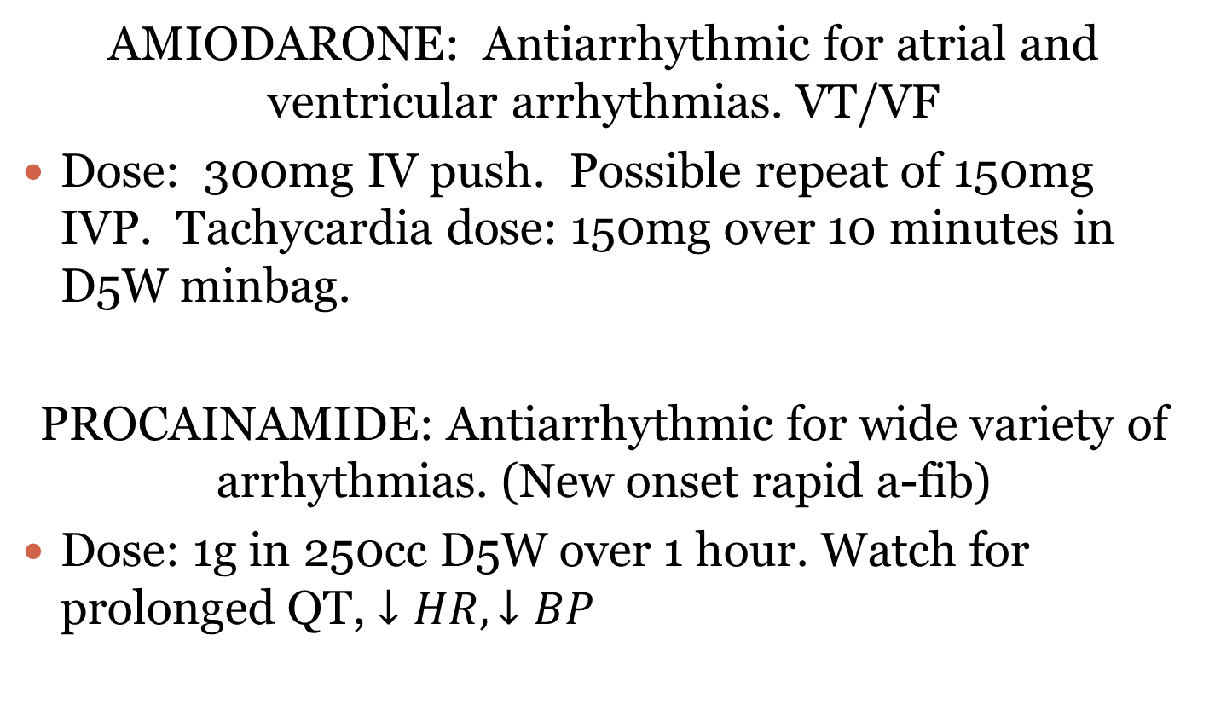
ACLS

Slide 115
ACLS
CALCIUM
Major role in initiation of sliding filaments in cardiac contraction.
Greater the calcium level = greater tension or inotropic force of heart.
Calcium Chloride | Calcium Gluconate
27 mg/ml (1 Amp) | 9 mg/ml (1 Amp)
3X the amount of calcium. Very irritating to the veins. Must have ECG monitoring.

Slide 116
References
Emergency Nurses Association. (2003). Sheeys emergency nursing principles and Practice. 5th edition. St. Louis, MO:Mosby
Sheey, SB & Lenehan, GP (1999). Manual of Emergency care. St. Louis, MO:Mosby
Kidd, PS, Sturt, PA, & Fultz, J (2000). Mosbys Emergency Nursing Reference. St. Louis, MO: Mosby.

Slide 117
References
An International Consensus on Science. The American Heart Association in Collaboration with the International Liaison Committee on Resuscitation. Guidelines 2000 for Cardiopulmonary Resuscitation and Emergency Cardiovascular Care. 2000
Granger, B.B. and Miller C.M.:Acute Coronary Syndrome: Putting the New Guidelines to Work, Nursing 2001. Volume 31, Number 11, November 2001
Palatnik, Anne Marie:How Cardiac Drugs Do What They Do,Nursing 2001.Volume 31, Number 5, May 2001.
McAvoy, Julia. Cardiac Pain: Discover the Unexpected, Nursing 2000. Volume 30, Number 3, March 2000.
Smith, Carol E.:Assessing Chest Pain--Quickly and Accurately, Nursing CE Handbook. March 1998
Roettig, M and Tanabe, P. Emergency Management of Acute Coronary Syndromes, Journal of Emergency Nursing 2000; 26(6): S1-42
Assent 3 Investigators. Assent3 randomized trial in Acute MI. Lancet 2001; 358: 605-13
Hoffmann-LaRoche limited. Product Monograph -TNKase October 17, 2001

